Slide 1
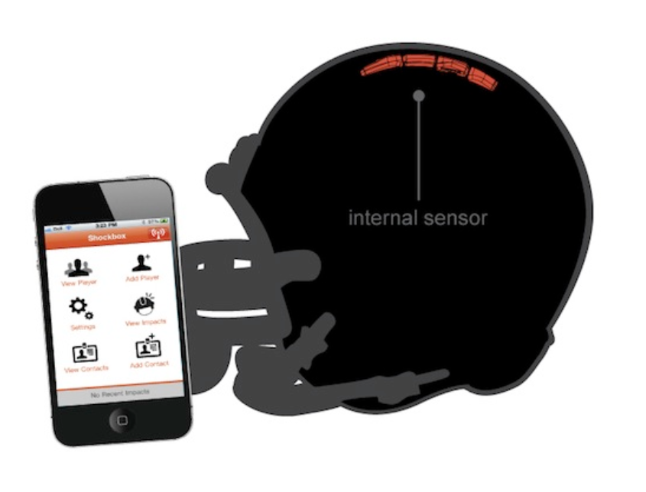
Helmet Integrated Impact
Detection System
(HI-IDS)
Presenter: Calvin Lee
Role: Software Development

Slide 2
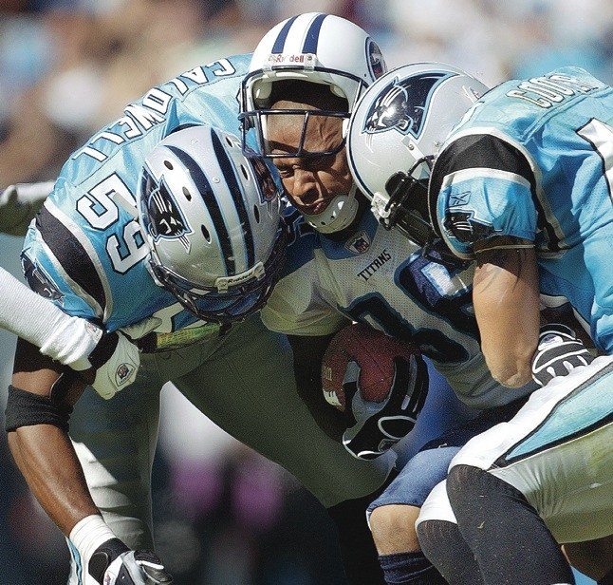
Concussions are a Serious Problem in Football !
Figure 1. NFL players making helmet on helmet contact.

Slide 3
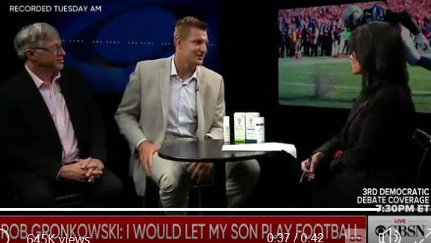
NFL Players Suffer Several Concussions
Figure 2. NFL player, Rob Gronkowski, admits he has suffered 20 concussions and 5 blackout moments.
Notes:
Sept.12,2019… New England Patriots, 5 blackouts

Slide 4


HI-IDS is Designed to Lower the Brain Damages to Players
Detect unreported concussions
Allow coaches and physicians to monitor head impacts
  receive alerts when a player is in danger of a concussion
Figure 3. Coaches monitoring players using mobile app. This will ensure coaches to receive alerts when players are injured.
Notes:
While at the same time … is durable and comfortable enough to be used like any regular football helmet
The software connect to the helmet will enable … to monitor…. And send alerts ..

Slide 5

Overview
Team
Technical Objectives
Desired Functionalities
Use Cases
Realistic Constraints
Standards Usage
System Requirements
Summary

Slide 6


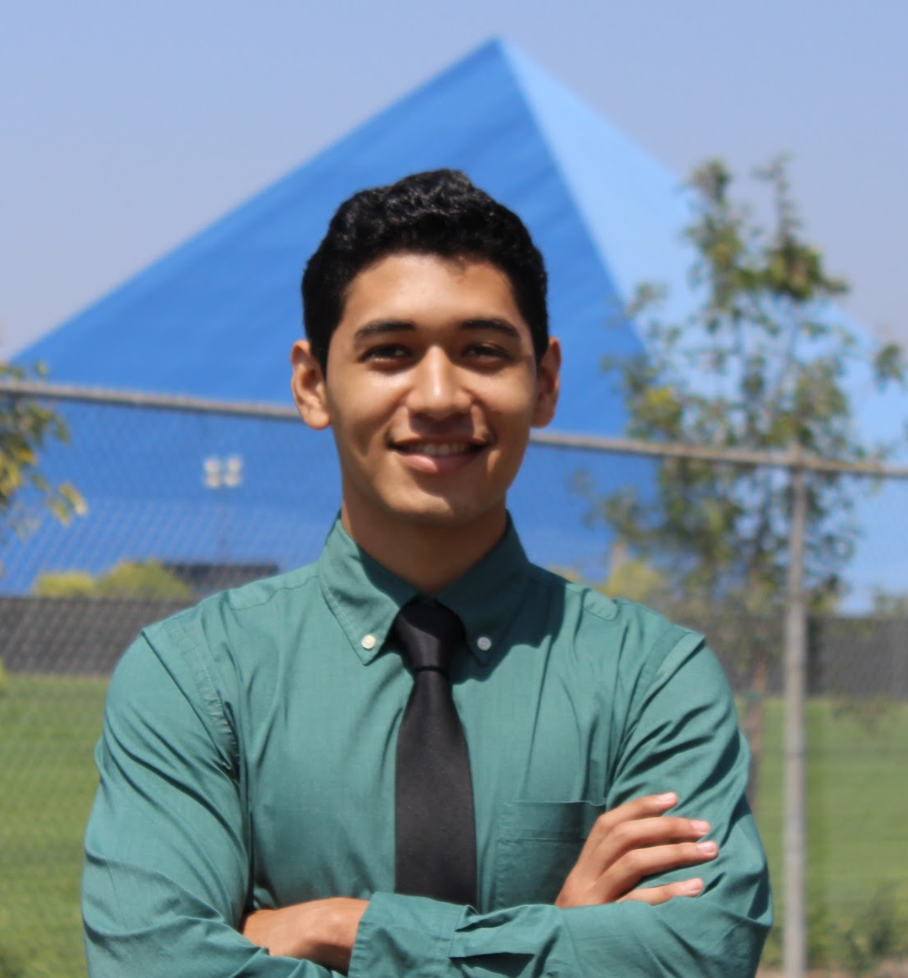

Members Qualification
Jasmine Arrieta
Role: Hardware Design
Emphasis: Electronics
Experience: 3D Printing, Creo, Python, Power Systems
Calvin Lee
Role: Software testing &
development
Emphasis: Communications
Experience: C++ / Python
Rhyan Gonzalez
Role: Hardware Design
Emphasis: Electronics
Experience: C++, VHDL, Matlab
Socheath Sok
Role: Software Design
Emphasis: BME
Experience: MATLAB, Simulink, VHDL, & Assembly

Slide 7
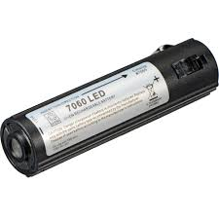
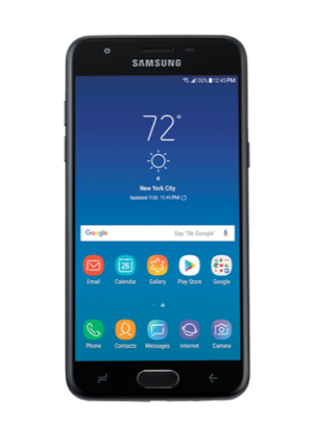
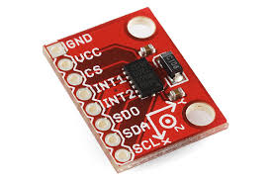

The Primary Focus is on Usability and Accuracy
Technical Objectives
  Seamlessly integrate the sensor into the helmet
  Measure impacts between +/- 200 G force
  Communication range of at least 100 meters
  Powered by rechargeable batteries
Figure 4. Sending sensor data to mobile app. By using the listed components, we can reach our technical objectives.

Slide 8

Necessary Functionalities To Detect Concussions
Measure collisions to the helmet
Transmit the data collected from the helmet wirelessly to an app
Send an alert on the app when a helmet collision exceeds a certain threshold
Display a history of impact data over a selected period of time

Slide 9
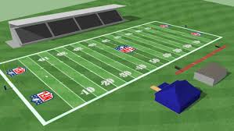
HI-IDS is Suitable for All Players
Use Cases
  Football players of any level
  Real games and practices
Software application is monitored by
  Coaches
  Physicians

Slide 10

HI-IDS is Safe and Effective
Social and Ethical
  App will be available on IOS and Android
    User interface must be simple and easy to navigate
  The final product must perform all of the desired functionalities
Manufacturability
  System must be properly connected before integrating into the helmet.
    Must not affect the player’s performance
Realistic Constraints
Figure 5. Android and IOS being friends. The helmet will be compatible on both IOS and Android devices.

Slide 11
Realistic Constraints cont.
Economic
  Manufacturing cost must be less than $85
  App can be connected to multiple devices
  Data must be able to transfer from the sensor to the app wirelessly
Environmental, Political, Health, and Safety
  Lithium ion battery must be recycled as hazardous waste
  System must not overheat
  This type of smart helmet has been done before

Slide 12
Standards Usage
IEC 60086-4 Ed. 4.0 b:2014
  Primary batteries - Part 4: Safety of lithium batteries
IEEE 802.11b-1999
  IEEE Standard for Information Technology - Telecommunications and information exchange between systems - Local and Metropolitan networks - Specific requirements - Part 11: Wireless LAN Medium Access Control (MAC) and Physical Layer (PHY) specifications: Higher Speed Physical Layer (PHY) Extension in the 2.4 GHz band
IEEE 836-2001
  IEEE Recommended Practice for Precision Centrifuge Testing of Linear Accelerometers
ISO/IEC 9126-1:2001
  Software engineering — Product quality — Part 1: Quality model
UHS-III
  UHS-III SD Memory Card Standard
Notes:
International Electrotechnical Commission, Institute of Electrical and Electronics Engineers, Ultra High Speed

Slide 13
Show
System Requirements

Slide 14
Concussion is a serious problem in football !
Figure 1. NFL players making helmet on helmet contact

Slide 15

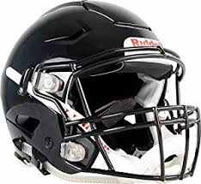
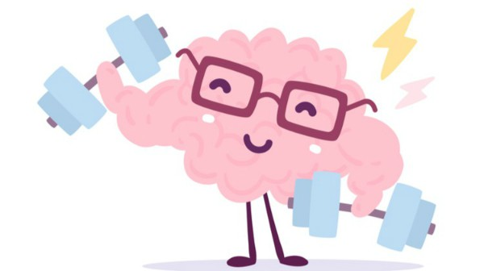
Our Solution !
HI-IDS to designed to help football players by allowing coaches and physicians to detect head impacts in order to diagnose possible concussions

Slide 16
References
Marklesparklesports. “Are the NFL Rules Getting Too Soft?” Markle Sparkle
Sports, Figure 1, 21 Aug. 2018, https://marklesparklesports.com/2018/08/20/are-the-nfl-rules-getting-too-soft/
CBS News. “Rob Gronkowski Says He Probably Had 20 Concussions and 5
Blackouts in His Career.” CBS News, CBS Interactive, 13 Sept. 2019, https://www.cbsnews.com/news/gronk-concussions-rob-gronkowski-former-new-england-patriots-tight-end-discusses-football-career-2019-09-12/.

Slide 17

Questions?

